Slide 1

Green Pace
Security Policy Presentation
Developer: Jeremy Depenhart

Slide 2

OVERVIEW: DEFENSE IN DEPTH
Defense in depth (DID) revolves around the fortification of data. This policy presentation will help inform our DID strategy by giving us information such as core principles, coding standards, C/C++ principles, Automation tools, and a threat matrix. This policy also provides definitions for the different forms of encryption and Triple A framework.

Slide 3
THREATS MATRIX
This matrix shows the likelihood and priority of different security rules. The likelihood and priority of each rule are determined in part by their level.
Likely STD-002-CPP (Probable) (L1) STD-003-CPP (Likely) (L1) STD-004-CPP (Likely) (L1) STD-005-CPP(Likely) (L1) | Priority STD-002-CPP (Probable) (L1) STD-003-CPP (Likely) (L1) STD-004-CPP (Likely) (L1) STD-005-CPP(Likely) (L1)
Low priority STD-001-CPP (Unlikely) (L3) STD-006-CPP (Unlikely) (L3) STD-007-CPP (Probable) (L3) STD-008-CPP (Probable) (L3) STD-009-CPP (Unlikely) (L3) STD-010-CPP (Unlikely) (L3) | Unlikely STD-001-CPP (Unlikely) (L3) STD-006-CPP (Unlikely) (L3) STD-007-CPP (Probable) (L3) STD-008-CPP (ProbabTherele) (L3) STD-009-CPP (Unlikely) (L3) STD-010-CPP (Unlikely) (L3)

Slide 4
10 PRINCIPLES
1. Validate Input Data
2. Heed Compiler Warnings
3. Architect and Design for Security Policies
4. Keep It Simple
5. Default Deny
6. Adhere to the Principle of Least Privilege
7. Sanitize Data Sent to Other Systems
8. Practice Defense in Depth
9. Use Effective Quality Assurance Techniques
10. Adopt a Secure Coding Standard
(Depenhart, 2024).

Slide 5
CODING STANDARDS
STD-001-CPP Data Type: Programs should only have a single definition for each data type.
STD-002-CPP Data Value: Do try to read a data value from uninitialized memory.
STD-003-CPP String Correctness: Do not try to create a string from a null pointer.
STD-004-CPP SQL Injection: Take steps to prevent SQL injection.
STD-005-CPP Memory Protection: Do not try to access memory that has already been freed.
STD-006-CPP Assertions: Use assertions to find defects that might become vulnerabilities.
STD-007-CPP Exceptions: Handle all exceptions.
STD-008-CPP Object Oriented Programming: Adhere to Object Oriented Programming principles.
(encapsulation, inheritance, polymorphism, and abstraction).
STD-009-CPP Integers: Do not cast enumeration values that are out of range.
STD-010-CPP Input Output: Close files once they are no longer needed.

Slide 6
ENCRYPTION POLICIES
Encryption at rest: Data is not in use. It is the least likely to be compromised by hackers. However, it should still remain encrypted in case of unauthorized access.
Encryption in flight: Data is being transferred. It is therefore at risk of interception.
Encryption in use: Data is in active use. It is the most at risk of being altered by unauthorized parties.

Slide 7
TRIPLE-A POLICIES
Authentication: Ensuing user validation so that only the correct users have access to accounts.
Authorization: Giving permissions only to those that need them.
Accounting: Keeping track of what is being accessed and who is accessing it.

Slide 8
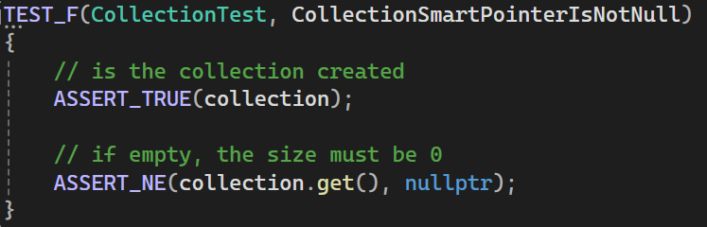
Unit Testing
Code snippet:
Test results:

Slide 9
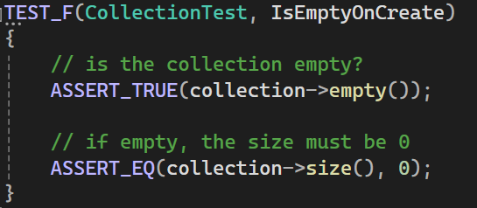
Unit Testing
Code snippet:
Test results:

Slide 10
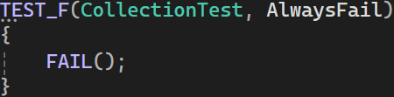
Unit Testing
Code snippet:
Test results:
*Note: this test was meant to always fail to test that failing tests can be detected

Slide 11
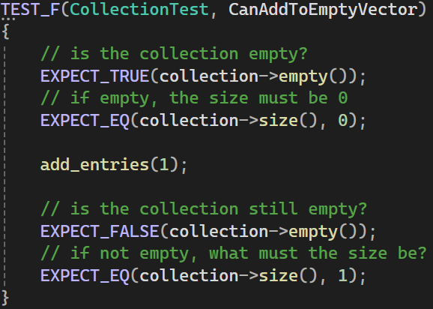
Unit Testing
Code snippet:
Test results:

Slide 12
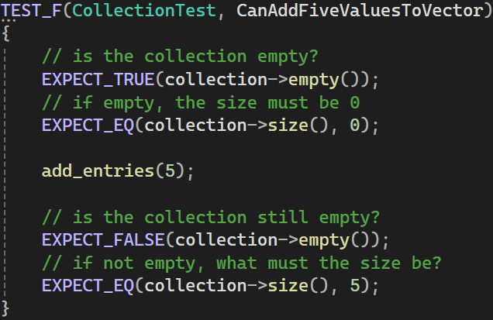
Unit Testing
Code snippet:
Test results:

Slide 13
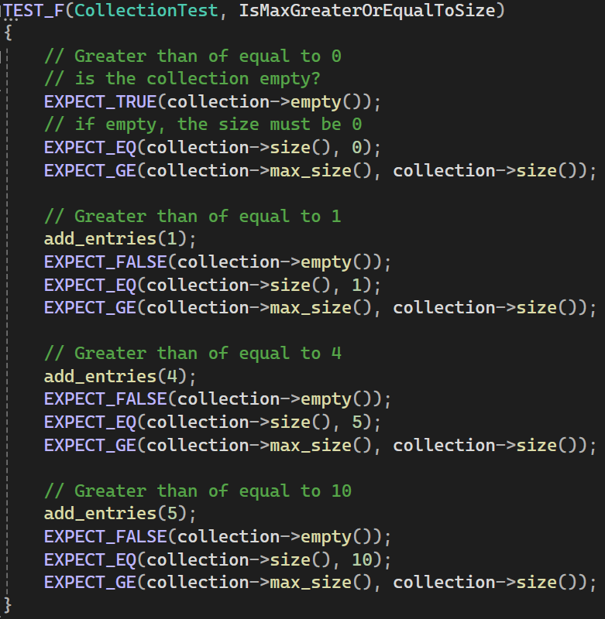
Unit Testing
Code snippet:
Test results:

Slide 14
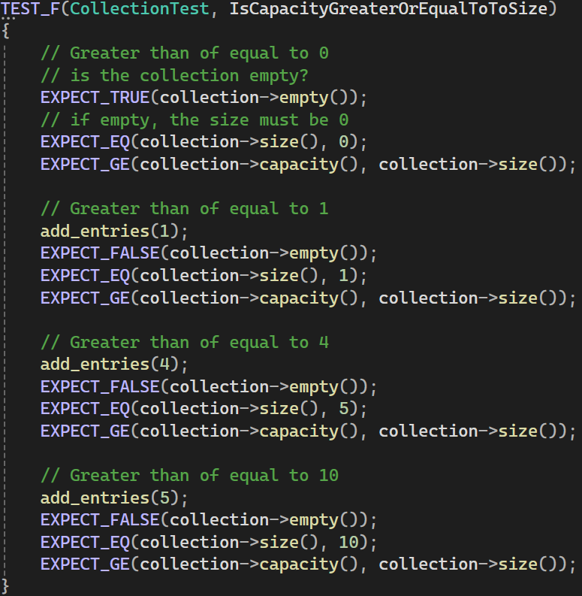
Unit Testing
Code snippet:
Test results:

Slide 15
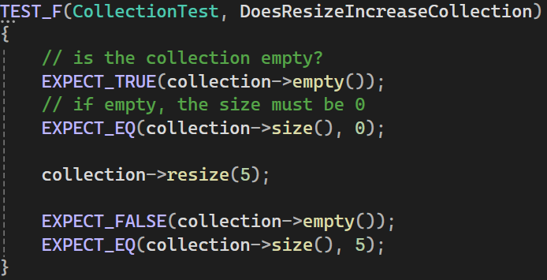
Unit Testing
Code snippet:
Test results:

Slide 16
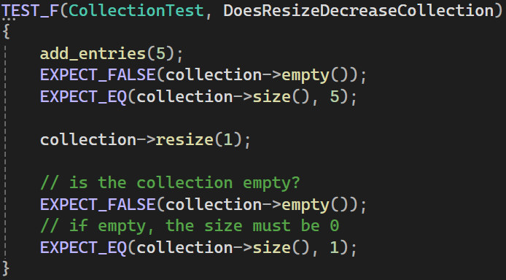
Unit Testing
Code snippet:
Test results:

Slide 17
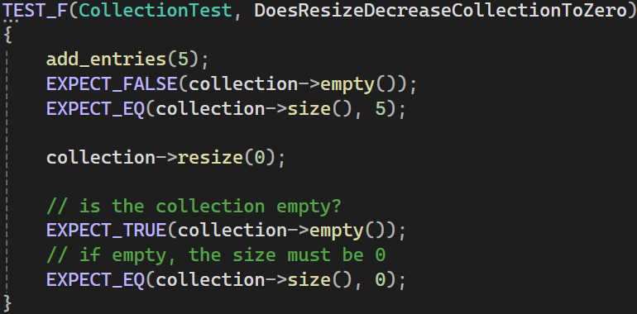
Unit Testing
Code snippet:
Test results:

Slide 18
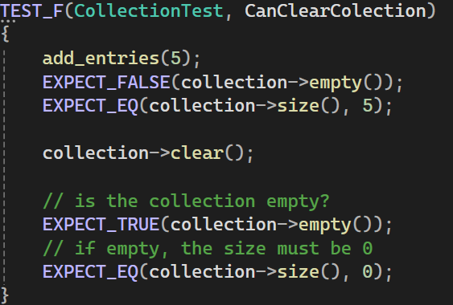
Unit Testing
Code snippet:
Test results:

Slide 19
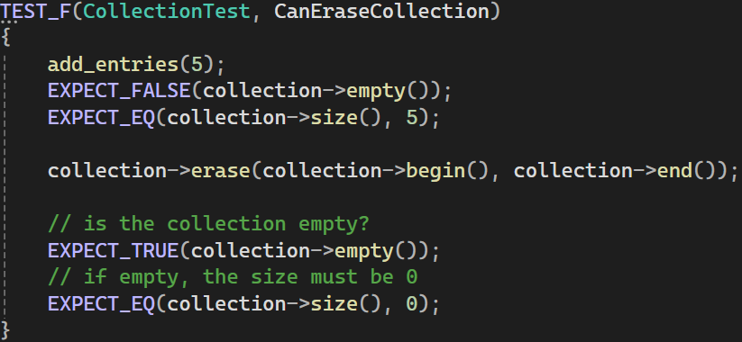
Unit Testing
Code snippet:
Test results:

Slide 20
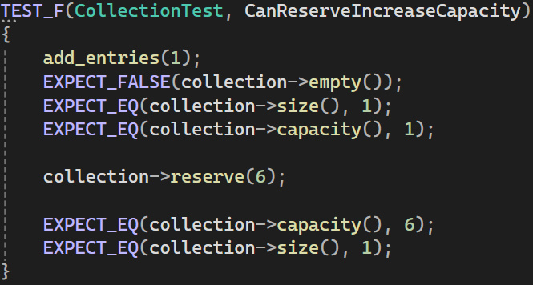
Unit Testing
Code snippet:
Test results:

Slide 21
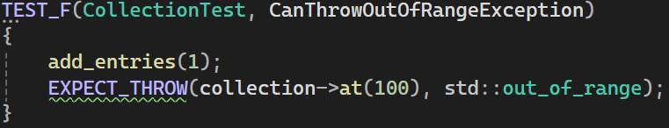
Unit Testing
Code snippet:
Test results:

Slide 22
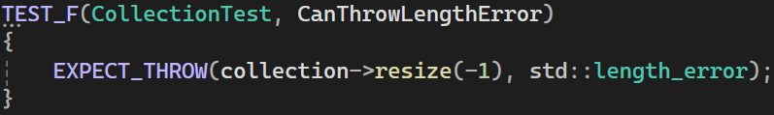
Unit Testing
Code snippet:
Test results:

Slide 23
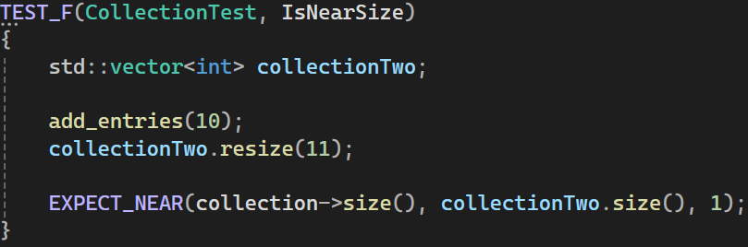
Unit Testing
Code snippet:
Test results:

Slide 24

AUTOMATION SUMMARY
There are numerous tools available for automating each of the security principles outlined. These tools can be incorporated into the earliest part of our DevOps process. It is essential to keep security in mind, from the beginning of a project, to publishing, and beyond. Automation enables us to save time and money in the process of securing our code. Once we have an idea of the product we are producing, something done in the Assess and Plan phase, we can plan the tool which will best suit the automation of our security.

Slide 25
TOOLS
Examples:
OOP51-CPP
Tool | Version | Checker | Description Tool
CodeSonar | 8.1p0 | LANG.CAST.OBJSLICE | Object Slicing
Helix QAC | 2024.1 | C++3072 | N/A
Parasoft C/C++test | 2023.1 | CERT_CPP-OOP51-a | Avoid slicing function arguments / return value
Polyspace Bug Finder | R2023b | CERT C++: OOP51-CPP | Checks for object slicing (rule partially covered)
PVS-Studio | 7.30 | V1054 | N/A

Slide 26
RISKS AND BENEFITS
Benefits:
Tighter security
Less breaches
Less overall/long-term cost
Early implementation leads to more effective security
Risks:
Costs more initially
Requires more training or the hiring of more secure programmers
Adds to code complexity
Takes more time to implement properly
While the initial risks seem to be more costly and time consuming, implanting this policy early will alleviate costs in the long run. Our products will be more secure, and our company will have a higher reputation. By contrast, waiting to implement this policy later will add to the cost and time of production and may not be as effective..

Slide 27
RECOMMENDATIONS
Gap analysis:
As it stands now, any current gap in security must be addressed and time must be dedicated to implementing security practices based on this policy. Going forward, security must be a focus from the beginning of a project, to the release phase, and beyond. Measures must also be taken to prevent issues such as data breaches, SQL injection, and more potential problems that can occur with our data.

Slide 28
CONCLUSIONS
In conclusion, the standards that should be adopted are:
Data Type
Data Value
String Correctness
SQL Injection
Memory Protection
Assertions
Exceptions
Object Oriented Programming
Integers
Input Output

Slide 29
REFERENCES
Depenhart, J. (2024, April 12). Green Pace Secure Development Policy.
Green Pace

